Slide 1
Erik Knudsen
Peter Willendrup
Emmanuel Farhi
And many other contributors:
Manuel Sanchez del Rio
Claudio Ferrero
Kell Mortensen
Robert Feidenshans’l
Kim Lefmann
McXtrace: X-ray Monte-Carlo ray-tracing

Slide 2
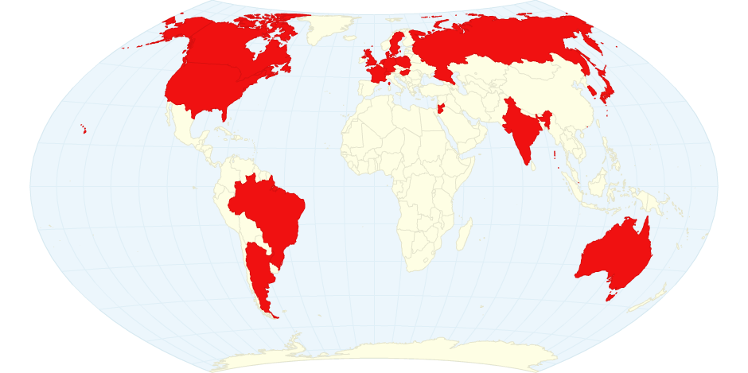











What is McXtrace ?
A software to simulate X-ray beam lines with incoherent and coherent sources, including optics, samples (scattering), detectors.
This is a ray-tracing code (Monte-Carlo).
Can easily couple to other codes.
Made to be extensible. Massively parallel.
DK
"McXtrace: a Monte Carlo software package for simulating X-ray optics, beamlines and experiments", Journal of Applied Crystallography, vol. 46 (2013) 679.

Slide 3
What can it be used for ?
Understand beam line as a whole.
Improve beam lines. “What if the ring lattice is changed ?”
Train users – plan experiments.
Help analyse data (limited by sample models).

Slide 4
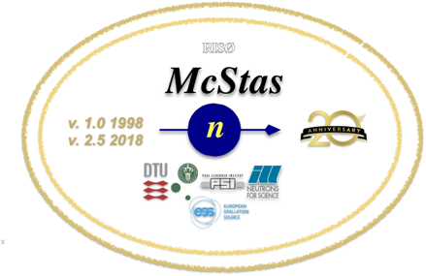
How does it work
Describe a beam-line in the McXtrace language (text file).
Automatically convert beamline into ANSI C
Compile (Automatically)
Run (Automatically)
1.Optimized for your platform
2.Only includes what you use
Built over proven McStas (neutrons) technology (1998-).
Produce data sets and plots, as well as 3D views.
Typical simulation time: 10s, up to few minutes.
User interfaces are in Python (also keep legacy Perl). Matlab interface.

Slide 5
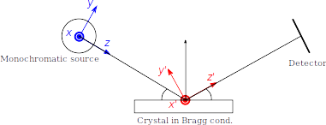
A photon particle is...
Photon ray/package:
(r,k,φ,t,p,E)
r - spatial coordinates
k - wave vector
φ - phase
t - time
p – photon weight
E - Electrical field polarisation

Slide 6



Installation
Available on all systems (Windows, Linux, Mac) at <http://www.mcxtrace.org/>.
[1.5 RC1: http://downloads.mcxtrace.org/mcxtrace-1.5rc1/]
Available as Virtual Machine <http://ord03246.synchrotron-soleil.fr> (exp.)
Available example at <https://sim.e-neutrons.org>
Help / Community
Extensive manuals, tutorials, examples.
Forum/mailing list.
Built over McStas – vast knowledge, community and expertise.
Code hosted at <https://github.com/McStasMcXtrace/McCode>

Slide 7


What you get in the box
A software that simply runs...
Components (80)
Sources
Optics
Samples
Detectors
A GUI to assemble and run BL.
Tools to view the results (e.g. detectors).
Tools to view the BL geometry.
Examples (40)
Extensive documentation, mailing list...
User interfaces and scripting (bash, Python, Matlab).
Single shot and parameter-scanned simulations.
Generated data files as text or HDF5/NeXus.
Fully adapted to HPC (MPI).
Optimisation (swarm, GA, simplex, Hooke, Powell, …) via iFit <http://ifit.mccode.org>

Slide 8
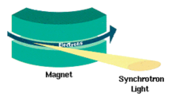
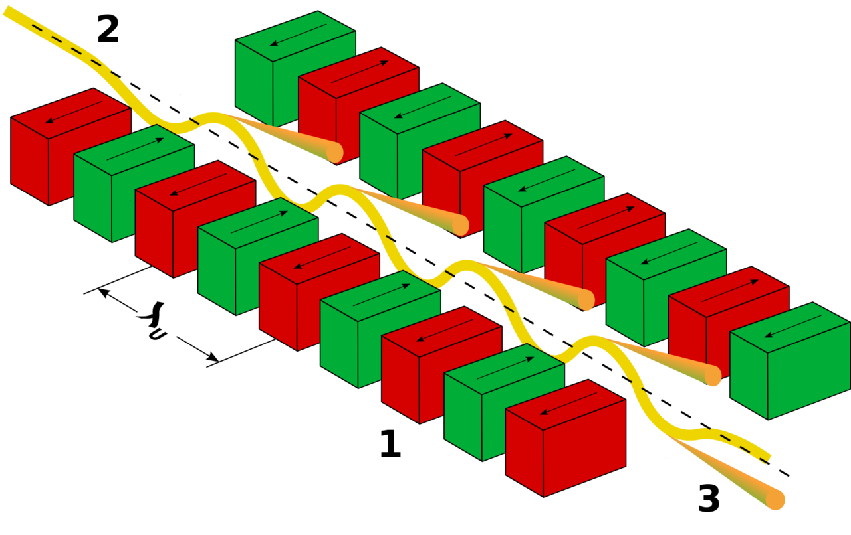
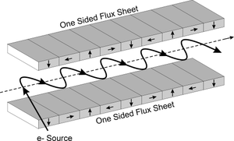
Sources
Synchrotron ID
Bending magnet [B.D. Patterson, Am. J. Phys. 79, 1046 (2011)]
Undulator [K.J. Kim, AIP, conf. proc., 184, 1989]
Wiggler [B.D. Patterson, Am. J. Phys. 79, 1046 (2011)]
Lab/ideal stuff
Laboratory X-ray tube (e.g. rotating anode)
Ideal, point and gaussian
Interfaces with other software
Spectra (R) <http://spectrax.org/spectra/>
Simplex (R) <http://spectrax.org/simplex/index.html >
Genesis (R) <http://genesis.web.psi.ch/>
Shadow (RW) <https://github.com/oasys-kit/shadow3>
MCPL (GEANT4, PHITS, MCNP) (RW) <https://mctools.github.io/mcpl/>

Slide 9
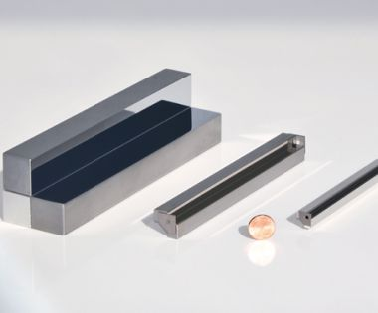
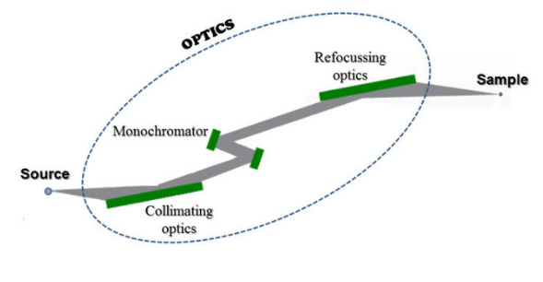
Optics
Enough to start with:
Bragg crystal (monochromator, incl. bent)
Capillary
Filter (absorption and refraction)
Lenses
Mirrors (flat, curved, multi-layers, twin KB multi-layer)
Zone plate
Grating (lamellar, blazed)
Slit, beam-stop, ...
More to come (with your help ?)
Components can be arranged in groups.

Slide 10

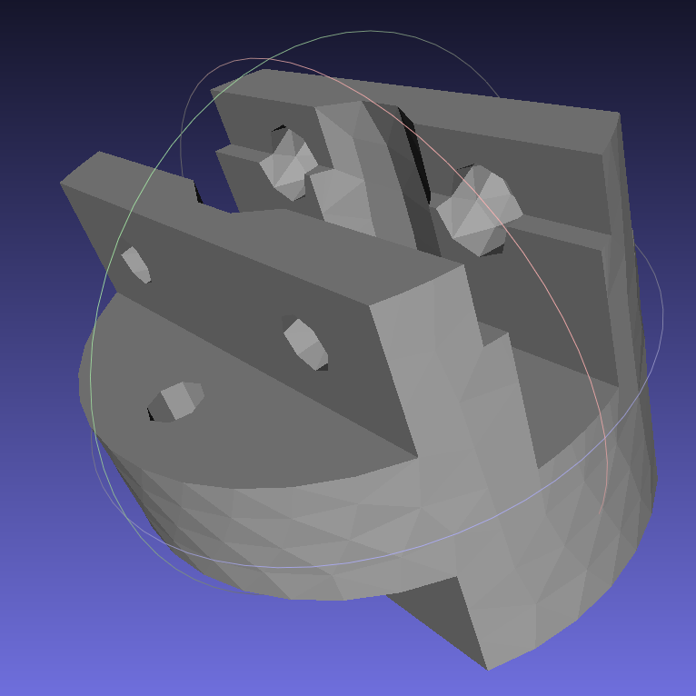
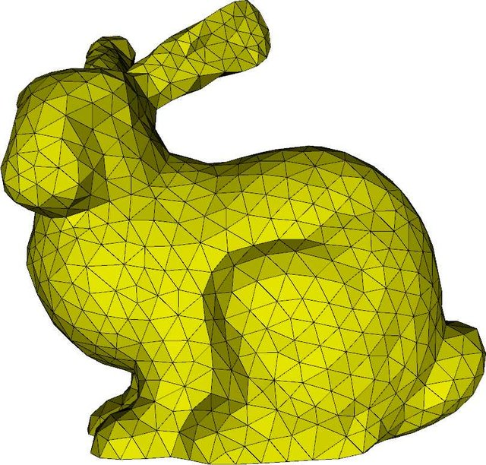
Samples
SAXS sample (60 models from SasView, PDB, Nanodiscs, Liposomes, I(q), …)
Powder (diffraction)
Polycrystal (diffraction)
Pump-probe (2 states) molecule
Single crystal (diffraction – hold on !)
All samples can have simple geometric shapes (incl. hollow).
Powder and SX can have any shape (PLY/STL).
Powder sample supports multiple concentric geometries (e.g. for cryostat).
McXtrace comes with a material data base, and can use e.g. NIST files.

Slide 11
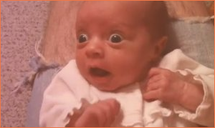
Detectors
Currently only record distributions (1D, 2D, event lists, …) for any combination of state parameters (position, divergence, energy, power, phase, E-field, …).
Not satisfactory !
Actual detector efficiency to be added (simple models exist), e.g.
<https://bl831.als.lbl.gov/~jamesh/mlfsom/>

Slide 12
Examples
SAXS
Powder
Single crystal
Coherence
MaxII 711 XRD/MX
DanMAX@MaxIV Powder XRD 2D https://sim.e-neutrons.org/instrument-menu/xrd/MAXIV_DanMAX_pxrd2d

Slide 13
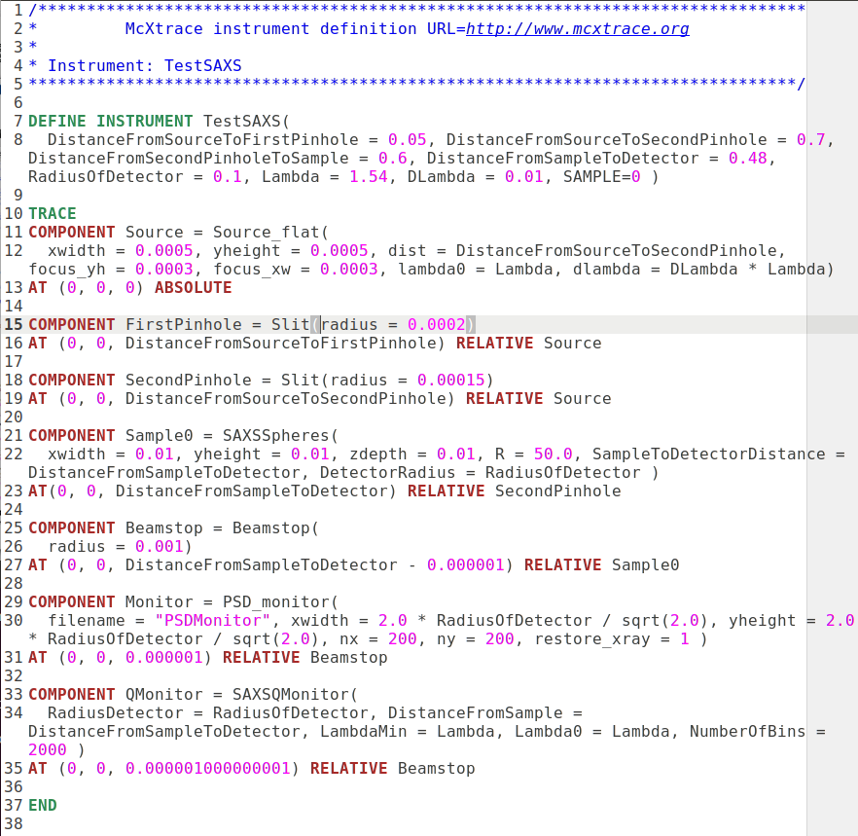
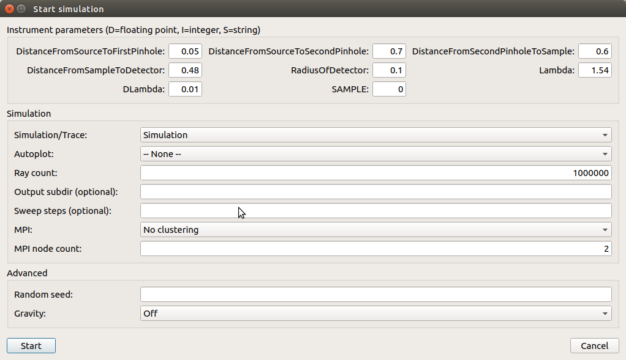
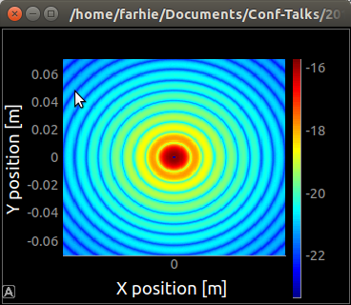
SAXS
11 s
Hard spheres colloid

Slide 14
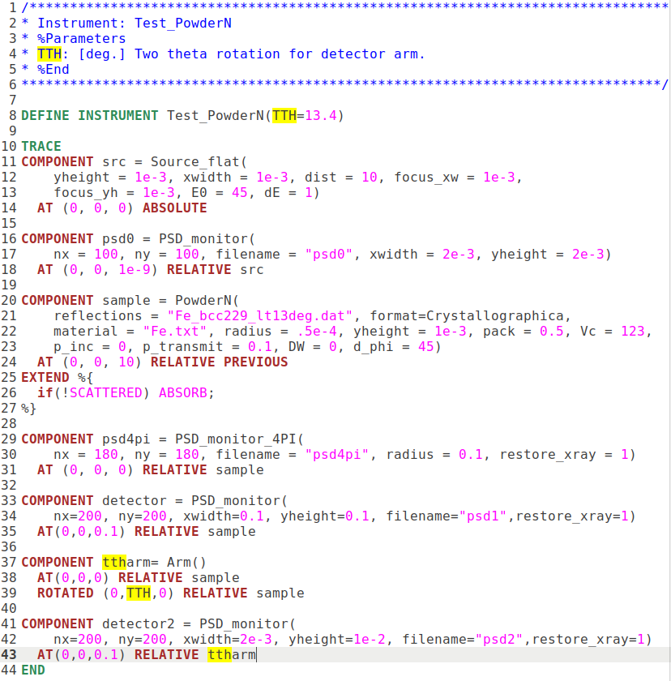
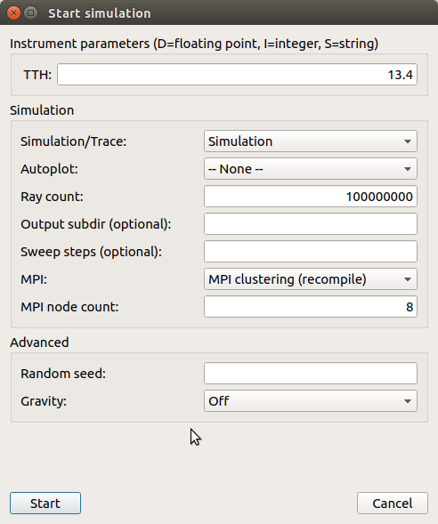
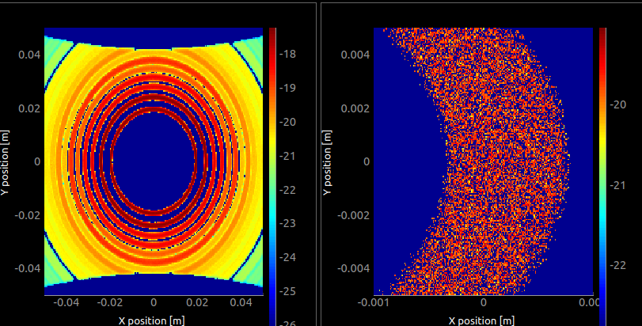
Powder Diff.
6 s
Fe bcc

Slide 15
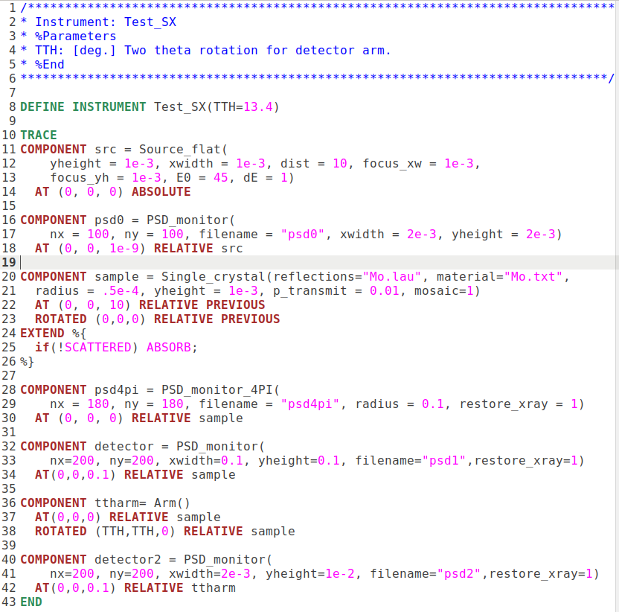
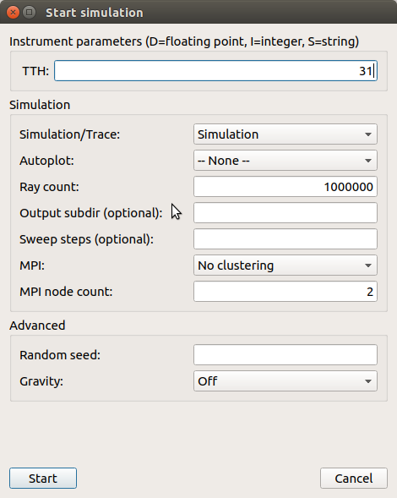
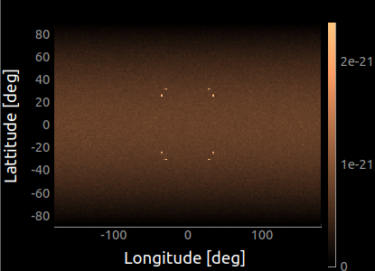
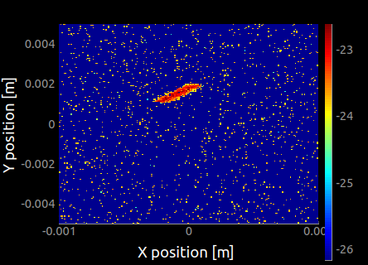
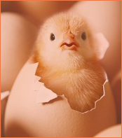
Single crystal diff.
32 s
Mo
Very early stage !

Slide 16
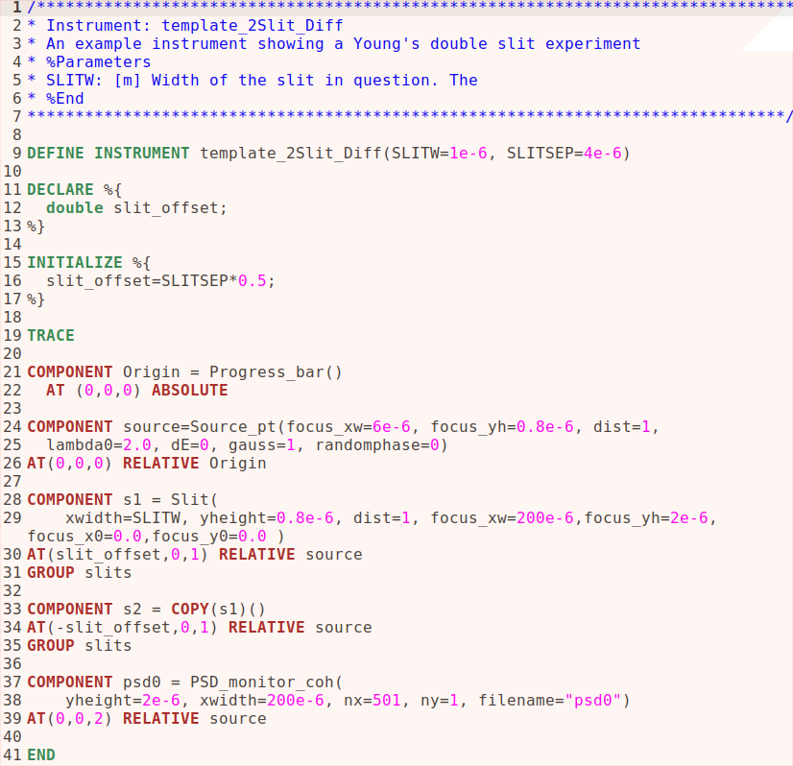
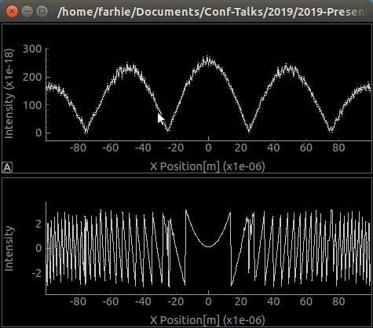
2 Slits interferences
1 s
Amplitude
Phase

Slide 17
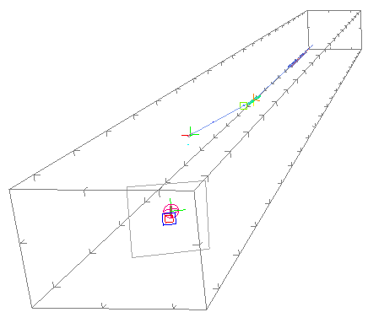
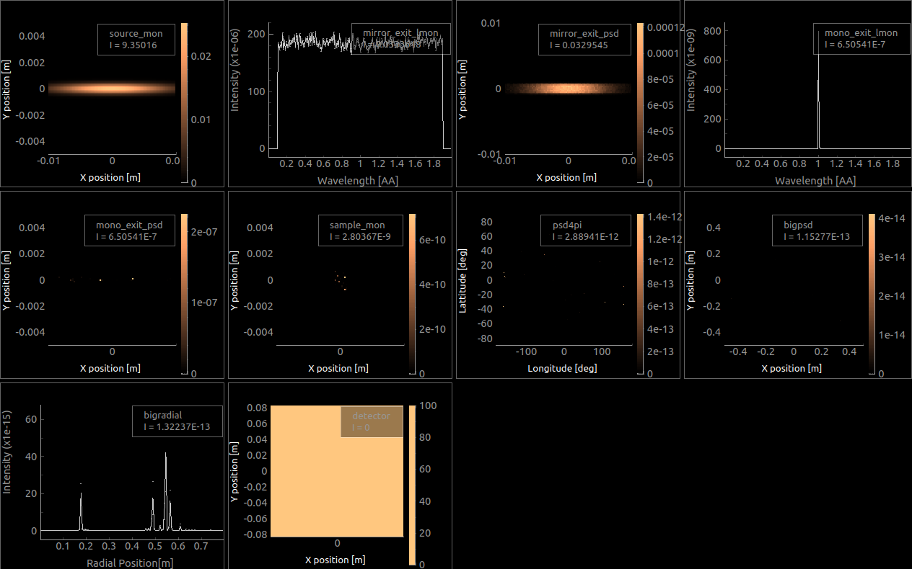
Max II 711 (MX)
A complete BL in 200 lines.
Execution: 40 s
3D view with ‘mxdisplay’
(WebGL in a browser)
Sample: Diamond powder

Slide 18
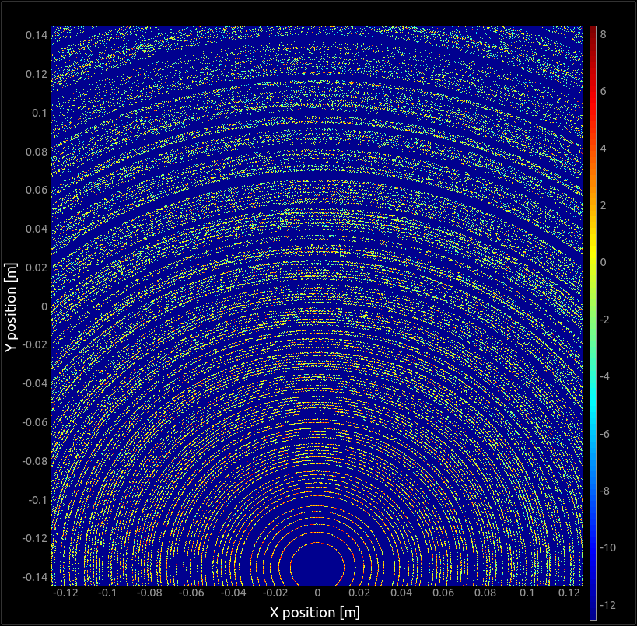
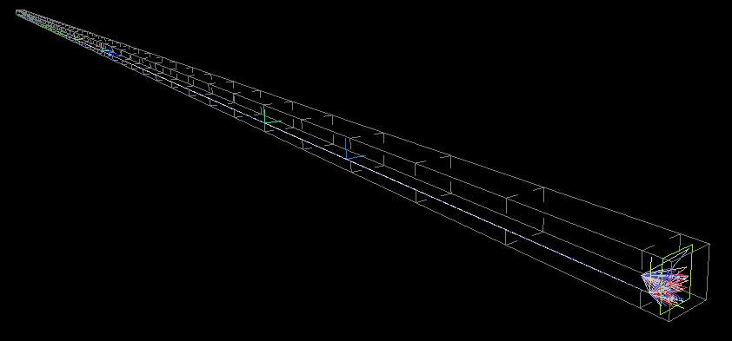
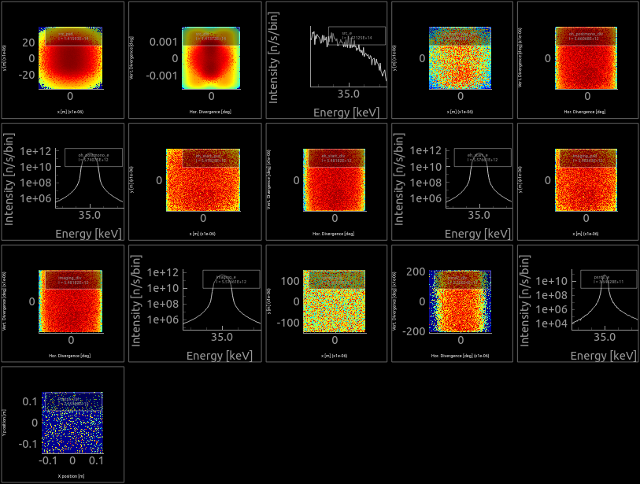
Max IV DanMAX (PXRD)
Try it on the web:
https://sim.e-neutrons.org/instrument-menu/xrd/MAXIV_DanMAX_pxrd2d
A complete BL in 500 lines.
Execution: 30 s
Sample: LaB₆

Slide 19
Limitations
Initially oriented towards ‘science’, not machine physics. That’s why we favour interfaces with other packages.
Can handle 100% coherent OR 100% incoherent beam.
BUT
Made to ease contribution and extend. Easy to learn.
Possibility to add new optics, samples and detectors. This is Open Source.
Particle (photon) description can be extended easily (add more state parameters to e.g. better describe coherent beams) to handle e.g. polarised BL.

Slide 20

The Future of McXtrace
Contribute to new sample kernels:
Single Xtal (validate)
EXAFS
IXS/XPS/ARPES [ S(q,w) exists ]
Contribute to new detector models:
From MLF-SOM (= MOS-FLM⁻¹)
Interfaces with e.g. HORUS, GEANT4, ...
Add more optics.
Tomography, ptychography...
On-going work to use GPU’s via NVIDIA OpenACC.
Add interface to OpenPMD (HDF5) particle/ray records
Couple to e.g. OASYS, SIMEX, COMSYL, SRW, … SpotX, Solemio ?
Tutorial/School as a Training for Soleil Staff planned at Soleil: 2-6 December 2019

Slide 21
How to contribute ?
Using McXtrace is already a good start. You can get a feeling in a few minutes...
You may then build new beam line descriptions. Generally 100-200 lines.
You further may adapt or build new components, e.g. 100-200 lines.
Send us an email or push on GitHub to allow others to benefit from your work:
emmanuel.farhi@synchrotron-soleil.fr
erkn@fysik.dtu.dk
http://www.mcxtrace.org/

